Slide 1
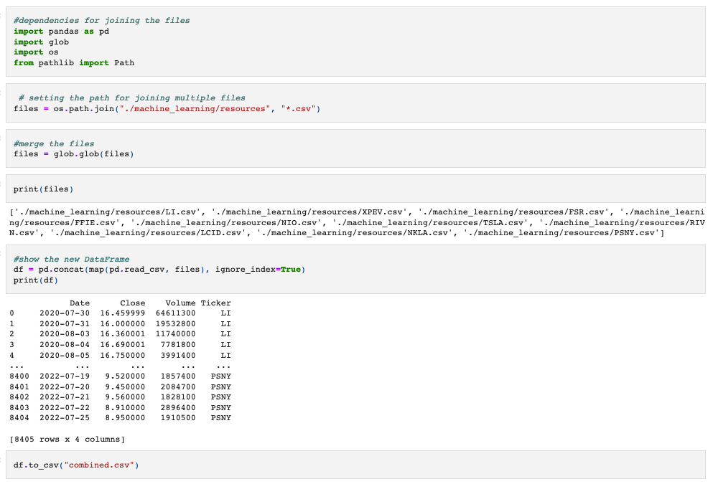
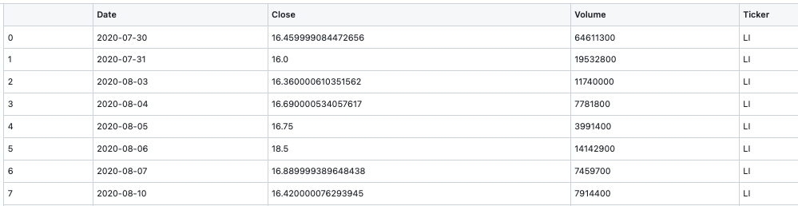
Data Exploration
Notes:
Proficiency talking points:
1) description of source data
2) description of the data exploration phase of the project
We began with creating an ERD to plan our tables but determined joining the tables with SQL would not be beneficial we switched to using Python and Jupyter Notebook

